Slide 1
Microsoft Visual C++ Compiler

Slide 2
Outline
Separate Your Code into Several Files
Fast compilation
Better re-use
C Preprocessor
#define
#ifdef
#include
_DEBUG
Linker
How to create your own library
Create DLL with Visual Studio

Slide 3
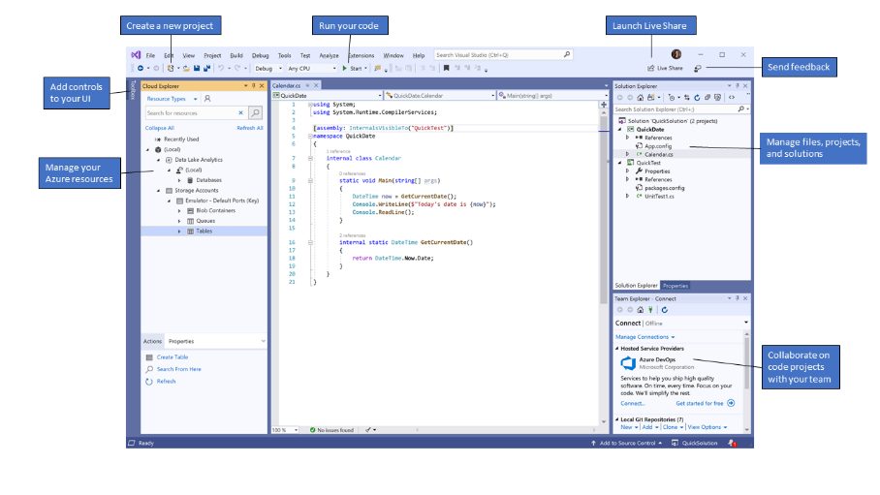
Visual Studio
Visual Studio consists of several languages:
BASIC
C/C++
C#
.NET
FORTRAN/F#
JavaScript
Python
Java
FoxPro
It is an IDE (integrated development environment):
Editor
Macro preprocessor
Compiler
Linker
Debugger

Slide 4
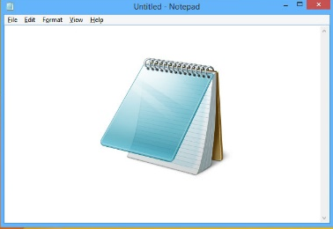
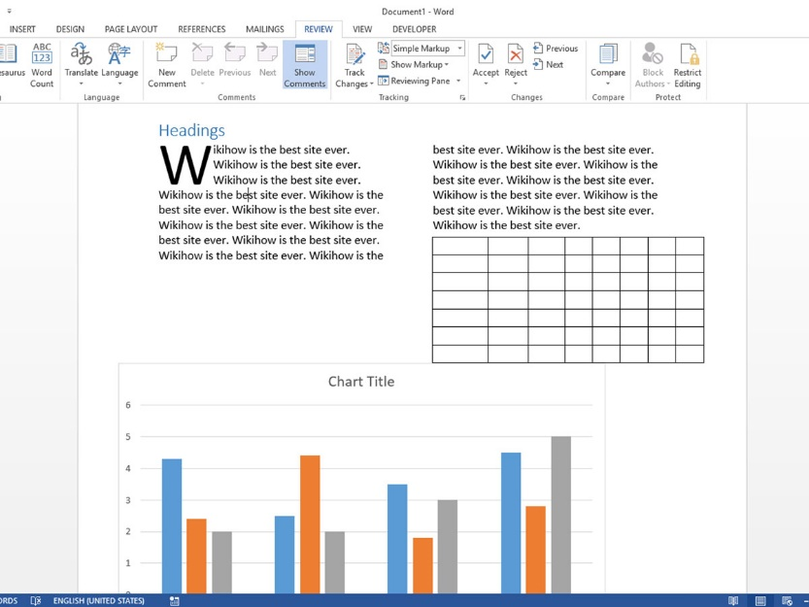
Text Editors
Notepad
Notepad++
VIM
Don’t be confused with a word processor (e.g. MS-Word) which provides fancy features such as font color, font size, underline, etc.

Slide 5
Fig. 3.14 Compilation and Linking
You compile the main program and the class GradeBook independently. Then link them to generate an executable program.:
g++ -c fig03_13.cpp
g++ -c GradeBook.cpp
g++ fig03_13.o GradeBook.o -o GradeBook

Slide 6
Static vs. Dynamic Library
A.exe
B.exe
C.exe
A.exe
B.exe
C.exe
Rectangle()
LineTo()
Ellipse()
Rectangle()
LineTo()
Ellipse()
Rectangle()
LineTo()
Ellipse()
DLL
DLL
DLL
Rectangle()
LineTo()
Ellipse()

Slide 7
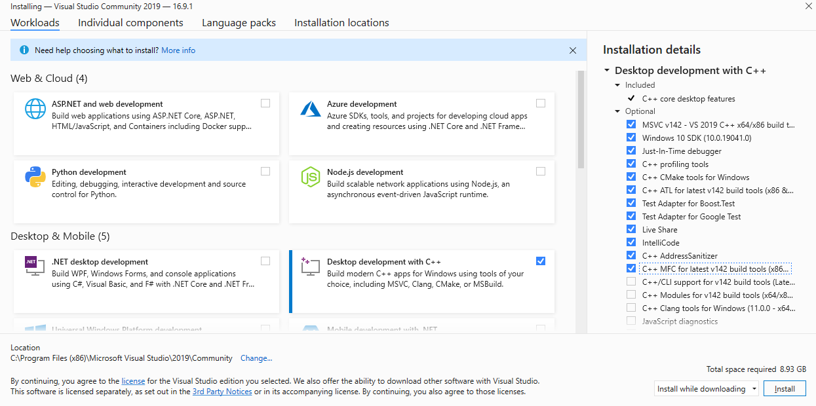
Visual Studio Installer

Slide 8
Command-line Tools
X64 Native Tools Command Prompt for VS2017
-E preprocess to stdout /E
/P preprocess to file
file.i
-D<name>=text /D
define a macro
-c compile without linking /c
-o file -Fe:file
Case-sensitive

Slide 9
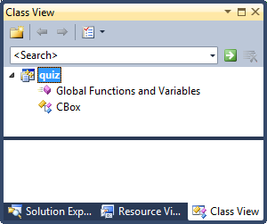
Accessing the Data Members of a Class
box2.m_Height = 18.0;
direct member selection operator
Ex7_02.cpp (P.281)
The definition of the class appears outside of the function main(), so it has global scope.
You can see the class showing up in the Class View tab.
If you did not see Class View in your Visual C++ 2010 Express, type Ctrl+Shift+C.

Slide 10
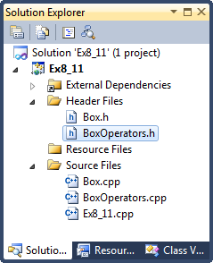
Organizing Your Program Code (P.403)
Ex8_13: Distribute the code among several files. (P.401)
This make it easy for you if you want to re-use any code from existing files in a new project.
.h - class definition
data members
function prototypes
.cpp - class implementation

Slide 11
#define
#define N 6
int main()
{
int i;
for (i=0; i<N; ++i)
cout << N << endl;
return 0;
}
int main()
{
int i;
for (i=0; i<6; ++i)
cout << 6 << endl;
return 0;
}

Slide 12
Macro Expansion
#define N 10
int main() {
#ifdef DEBUG
printf("[DEBUG] ");
#endif
printf("%d\n", N);
return 0;
}
CL /E /DEBUG a.c
This is equivalent to “clang -E -DDEBUG a.c” on Unix.

Slide 13
#include
add.c
int add(int x, int y) {
return x + y;
}
#include "add.c"
#include "gcd.c"
int main() {
int i = add(24, 36);
int j = gcd(24, 36);
return 0;
}
gcd.c
int gcd(int x, int y) {
for (int i=y; i>=1; --i)
if ( x % i == 0 && y % i == 0)
return i;
return -1;
}

Slide 14
The 3 Files Are Merged Before Being Compiled
int add(int x, int y) {
return x + y;
}
int gcd(int x, int y) {
for (int i=y; i>=1; --i)
if ( x % i == 0 && y % i == 0)
return i;
return -1;
}
int main() {
int i = add(24, 36);
int j = gcd(24, 36);
return 0;
}

Slide 15
The macro processor simply merges them, without checking syntax correctness.
#include "gcd.1"
#include "gcd.2"
int main() {
int j = gcd(24, 36);
return 0;
}
int gcd(int x, int y) {
for (int i=y; i>=1; --i)
if ( x % i == 0 && y % i == 0)
return i;
return -1;
}

Slide 16
#ifdef
#ifdef __unix__
#define OS "Unix"
#elif defined(_WIN32) || defined(WIN32)
/* either 32-bit or 64-bit */
#define OS "Windows"
#endif
#include <iostream>
using std::cout;
using std::endl;
int main()
{
cout << OS << endl;
return 0;
}

Slide 17
Preprocessor Wrapper (Chapter 9, P.414)
#ifndef DATE_H
Class Date { . . }
#define DATE_H
#endif
This prevents headers from being included more than once.

Slide 18
#ifdef, #ifndef
#ifndef N
#define N 10
#endif
#include <stdio.h>
int main() {
int i;
for (i=1; i<=N; i++)
printf("%d", i);
printf("\n");
return 0;
}
gcc -DN=6 d.cpp

Slide 19
#include
Compiling “main.cpp”, it will automatically include the contents of “add.cpp”.
add.cpp
int add(int a, int b)
{
return a+b;
}
main.cpp
#include <iostream>
using std::cout;
using std::endl;
#include "add.cpp"
int main()
{
cout << add(3, 5) << endl;
return 0;
}

Slide 20
The Issue of “Re-definition” (P.413)
class Date {
int year;
int month;
int day;
};
#include "date.h"
class Student {
char name[20];
Date birthday;
};
#include "date.h"
class Teacher {
char name[20];
Date birthday;
};
#include "student.h"
#include "teacher.h"
int main() {
Student one;
Teacher two;
return 0;
}
Compiling this main program.
error: redefinition of ‘class Date’

Slide 21
#pragma once
person.cpp
class Person {
public:
char name[20];
};
student.cpp
#include "person.cpp"
class Student : public Person {
public:
char stu_id[10];
};
teacher.cpp
#include "person.cpp"
class Teacher : public Person {
public:
char teacher_id[10];
};
main.cpp
#include "student.cpp"
#include "teacher.cpp"
error: redefinition of 'class Person'

Slide 22
Solution: (Visual C++ Only)
#pragma_once
class Person {
public:
char name[20];
};

Slide 23
Solution:
#ifndef PERSON_CPP
#define PERSON_CPP
class Person {
public:
char name[20];
};
#endif

Slide 24
#pragma once
#ifndef DATE_H
Class Date { . . }
#define DATE_H
#endif
This is the standard way to implement an “include guard”.
Disadvantages:
Longer code
Name clashes
It can be equivalently written as
#pragma once
Class Date { . . }
as long as your compiler supports it.
Clang
GCC
Microsoft Visual C++

Slide 25
_DEBUG
#include <iostream>
using std::cout;
using std::endl;
int add(int a, int b) {
#ifdef _DEBUG
cout << "[DEBUG] Input: " << a << ',' << b << endl;
#endif
return a + b;
}
int main() {
cout << add(3, 5) << endl;
return 0;
}

Slide 26
Create a Static Library Project on VS2017
Create
File – New – Project - myLib
Application type – Visual C++ - Windows Desktop – Static Library (.lib)
(?) Additonal Options, un-check “Pre-compiled header”

Slide 27
Using the Static Library in an Application
Create myApp
General – Empty Project
Add – Reference – Projects – myLib
Configuration Properties – C/C++ - General – Additional Include Directories – myLib/myLib
You can now #include “myLib.h” in your .cpp
Linker – General – Additional Library Directory
Linker – Input – Additional Dependency

Slide 28
Command-line Tools
CL /c myLib.cpp
Compile without linking
This will generate “myLib.obj”
LIB myLib.obj
Create the static library “myLib.LIB”
CL -c myApp.cpp -I ..\..\myLib\myLib
LINK myApp.obj myLib.lib /LIBPATH:..\..\myLib\myLib
or CL myApp.obj myLib.lib /link /LIBPATH:..\..\myLib\myLib
CL myApp.cpp myLib.lib -I ..\..\myLib\myLib /link /LIBPATH:..\..\mylib\myLib
Must be lowercase

Slide 29
myLib.cpp
int gcd(int m, int n)
{
if (m == 0)
if (n == 0)
return 0;
else
return n;
else
return gcd(n%m, m);
}

Slide 30
Create your DLL in Visual Studio 2017
New Project – Dynamic-Linking Library (DLL)
Name: “MyDLL”
Make sure “Create directory for solution” is checked (this is default).
MyDLL.cpp
#include "stdafx.h"
#include "MyDLL.h"
int myAdd(int a, int b)
{
return a + b;
}

Slide 31
MyDLL.h
Header Files – Add – New Item
#pragma once
#ifdef MYDLL_EXPORTS
#define MYDLL_API __declspec(dllexport)
#else
#define MYDLL_API __declspec(dllimport)
#endif
extern "C" MYDLL_API int myAdd(int a, int b);
To call the function exported by a DLL, client source code must have the declarations available at compile time.
Now Build the project. You should see MyDLL.lib and MyDLL.dll created in
C:\Users\Solomon\source\repos\MyDLL\Debug.

Slide 32
Calling Functions in a DLL from Your Program
Create an Empty Program (e.g., “MyTest”)
#include <iostream>
#include "MyDLL.h"
using std::cout;
using std::endl;
int main()
{
cout << 3 + 5 << endl;
cout << myAdd(3, 5) << endl;
}
You cannot build this project yet.
Be patient, and
see the next page.

Slide 33
Build a Shared Object (.so) Library with GCC on Unix
// Compile with
// gcc -shared -fPIC dl_calculate.c -o libcalculate.so
int add(int a, int b) {
return a + b;
}

Slide 34
Build a Program on Unix Which Calls Functions Dynamically
// Compile with
// gcc -rdynamic -o dl_main dl_main.c -ldl
// Shared Object (SO)
// Also known as Dynamic Linking Library (DLL) on Windows
#include <stdio.h>
#include <stdlib.h>
#include <dlfcn.h>
// Specify the path to the shared library
#define LIB_CACULATE_PATH "./libcalculate.so"
//Pointer to Function
typedef int (*FUNC)(int, int);
int main()
{
void *handle;
char *error;
FUNC func = NULL;
// Open a file for dynamic linker
handle = dlopen(LIB_CACULATE_PATH, RTLD_LAZY);
if (!handle) {
fprintf(stderr, "%s\n", dlerror()); // dlerror() returns a string.
exit(EXIT_FAILURE);
}
// At each call to dlerror(), the error indication is reset.
dlerror();
// Returns the address binding to “add”.
*(void **) (&func) = dlsym(handle, "add");
if ((error = dlerror()) != NULL) {
fprintf(stderr, "%s\n", error);
exit(EXIT_FAILURE);
}
printf("add: %d\n", (*func)(2,7));
// deletes a reference to the shared object referenced by handle.
dlclose(handle);
exit(EXIT_SUCCESS);
}
Notes:
In Visual Studio, MyDLL.LIB handles dlopen() and dlsym().
Client - MyDLL.LIB - MyDLL.dll
On Unix, your Client interacts with .so directly, so it must handle dlopen() and dlsym().

