Slide 1
Building an Executable File
Editor
(nano, vim)
Library
hw01.cpp
hw01.o
hw01.exe
Source Code
Compiler
(g++)
Object Code
Executable File
Linker
nano hw01.cpp
g++ -c hw01.cpp
g++ hw01.o -o hw01.exe

Slide 2
insert.cpp
void sort(int a[], int n) {
int temp;
for (int i=0; i<=n-2; ++i)
for (int j=n-1; j>=1; --j)
if (a[j-1] > a[j]) {
temp = a[j-1];
a[j-1] = a[j];
a[j] = temp;
}
}

Slide 3
quick.cpp
#include <cstdlib>
int cmp(const void* p1, const void* p2) {
int n1 = *reinterpret_cast<const int*>(p1);
int n2 = *reinterpret_cast<const int*>(p2);
return n1 - n2;
}
void sort(int a[], int n) {
qsort(a, n, sizeof(int), cmp);
}

Slide 4
main.cpp
#include <iostream>
#include <cstdlib>
#include <unistd.h>
#include <sys/time.h>
#ifndef N
#define N 10
#endif
void sort(int a[], int n); // Function prototype
using std::cout;
using std::cin;
int main() {
int A[N];
FILE* fp;
if (access("a.txt", F_OK)) { // return 0 if succeed; -1 if fail.
// Generate random input
fp = fopen("a.txt", "w");
for (int i=0; i<N; ++i)
fprintf(fp, "%d%c", rand() % N,
i==N-1?'\n':' ');
fclose(fp);
}

Slide 5
main.cpp (cont.)
// Read input
fp = fopen("a.txt", "r");
for (int i=0; i<N; ++i)
fscanf(fp, "%d", &A[i]);
fclose(fp);
struct timeval tv1;
struct timeval tv2;
time_t tv_sec; /* seconds */
suseconds_t tv_usec; /* microseconds */
gettimeofday(&tv1, NULL);
sort(A, N);
gettimeofday(&tv2, NULL);
tv_sec = tv2.tv_sec - tv1.tv_sec;
if (tv2.tv_usec >= tv1.tv_usec)
tv_usec = tv2.tv_usec - tv1.tv_usec;
else {
tv_usec = 1000000 + tv2.tv_usec - tv1.tv_usec;
--tv_sec;
}
for (int i=0; i<N; ++i) {
cout << A[i];
cout << (i==N-1?'\n':' ');
}
printf("Execution Time: %ld.%06ld seconds\n", tv_sec, tv_usec);
return 0;
}

Slide 6
Object Files Can Be Shared
insert.cpp
main.cpp
quick.cpp
compile
compile
compile
insert.o
link
main.o
link
quick.o
insert.exe
quick.exe
g++ -c main.cpp
g++ -c insert.cpp
g++ main.o insert.o -o insert.exe
g++ -c quick.cpp
g++ main.o quick.o -o quick.exe
Notes:
When N=10, Insertion Sort takes 1μs, while Quick Sort takes 3μs.
When N=10000, Insertion Sort takes 1.5s, while Quick Sort takes 7ms.

Slide 7
What files should be re-generated?
If you modified insert.cpp, then insert.o and insert.exe must be re-generated.
If you modified main.cpp, then main.o and both insert.exe and quick.exe must be re-generated.
It would be nice if your computer can automatically detect which source files are modified, and determine which target files must be re-generated.

Slide 8
Makefile
The first is the default target.
all: insert.exe quick.exe
main.o: main.cpp
g++ -c main.cpp
insert.o: insert.cpp
g++ -c insert.cpp
quick.o: quick.cpp
g++ -c quick.cpp
quick.exe: quick.o main.o
g++ quick.o main.o -o quick.exe
insert.exe: insert.o main.o
g++ insert.o main.o -o insert.exe
clean:
rm *.o *.exe
target
source
rule to generate the target
tab instead of space
make insert.o
make insert.o
make quick.exe
make clean
make all
make clean
make -n insert.o
make
dry run

Slide 9
You only need to prepare a CPP file
In the exercise of “Sorting with Linked-List” (https://moodle.ncnu.edu.tw/mod/assign/view.php?id=884547):
TA will prepare the following files:
listElement.h
This file will be included by main.cpp, printList.cpp, and your 112321000.cpp
main.o
g++ -c main.cpp
printList.o
g++ -c printList.cpp
You will submit your program 112321000.cpp
TA will compile it by “g++ -c 112321000.cpp”.
Then it will be linked with other object files to generate an executable file:
g++ main.o printList.o 112321000.o -o 112321000.exe

Slide 10
宣州謝朓樓餞別校書叔雲
棄我去者，昨日之日不可留；
亂我心者，今日之日多煩憂。
長風萬里送秋雁，對此可以酣高樓。
蓬萊文章建安骨，中間小謝又清發。
俱懷逸興壯思飛，欲上青天覽明月。
抽刀斷水水更流，舉杯銷愁愁更愁。
人生在世不稱意，明朝散髮弄扁舟。
～ 李白

Slide 11
Running C++ Programs on FreeBSD

Slide 12
BUILDING
A
PROGRAM

Slide 13
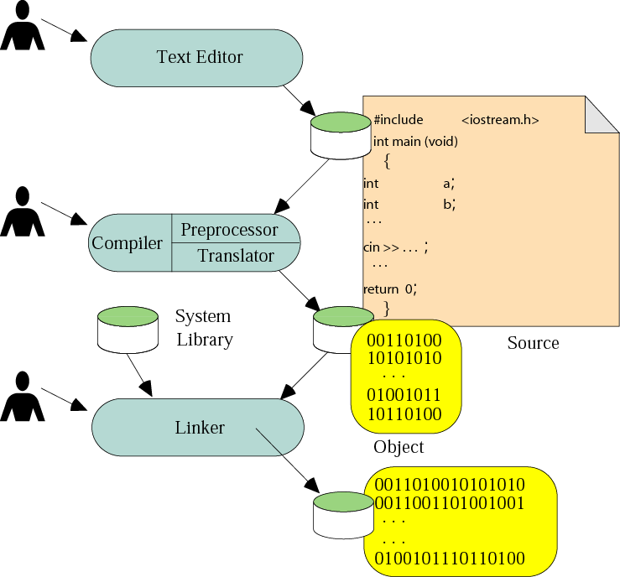
Building a program
The steps to build a program include writing, editing, compiling, and linking code.

Slide 14
Building C++ Programs on FreeBSD
Log into STU.csie.ncnu.edu.tw
Edit a source file
You may use your favorite editors such as vi, ee
ee test.cpp
Compile the C++ source file to an executable program.
g++ test.cpp
Run the executable file
./a.out

Slide 15
Mid-Term Exam
Date: 12/3 (Friday)
Time: 08:10-10:00
Scope:
bwBASIC
Visual C++,
Chapter 1 – Chapter 4 (Array, String)
Open Book
You have seen all the English vocabularies in the textbook or the homework, so do not ask the TA to explain the questions.

Slide 16
9.3
PROGRAM
EXECUTION

Slide 17
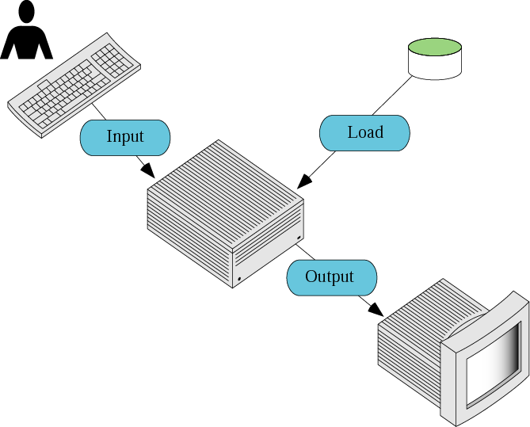
Program execution

