Slide 1
cURL and the Road to Object-Oriented

Slide 2
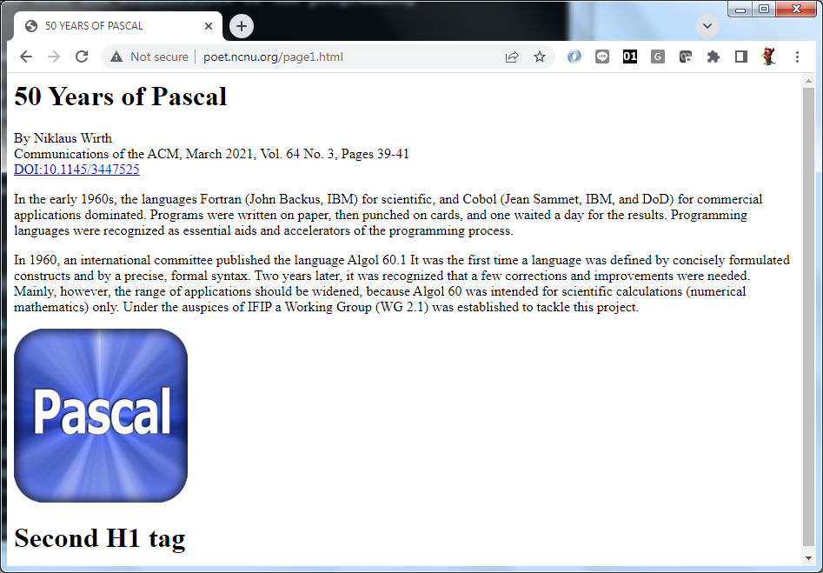
Webpages you see in a browser …

Slide 3
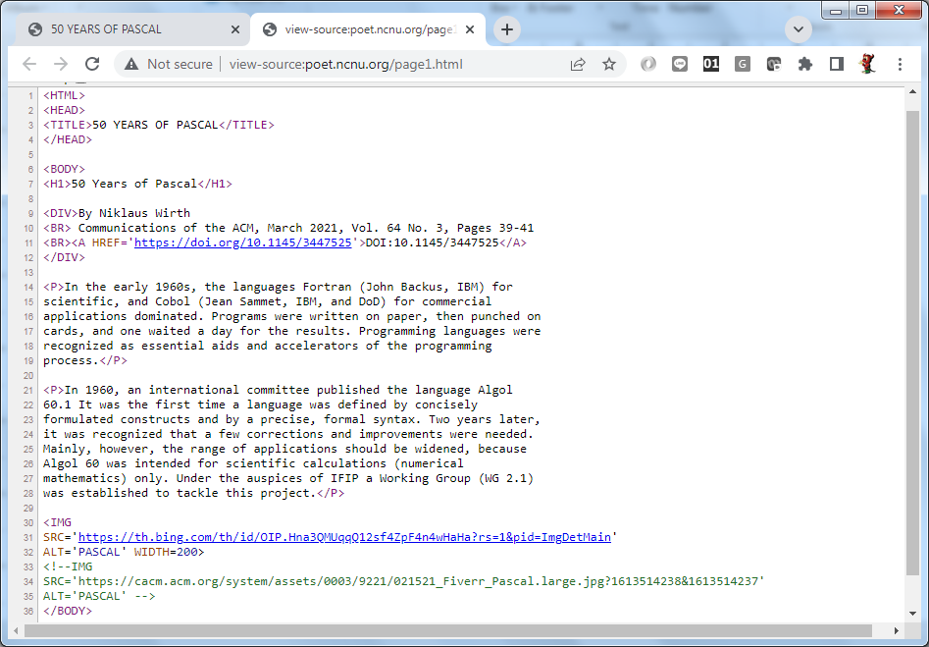
is actually an HTML file interpreted and formatted by software
Exercise:
Visit a webpage, e.g., http://poet.ncnu.org/page1.html
View its HTML source (by Ctrl-U)

Slide 4
Sharing Data on the Internet
Router
Internet
Alice
LAN
Web Server
poem02.txt
Bob

Slide 5
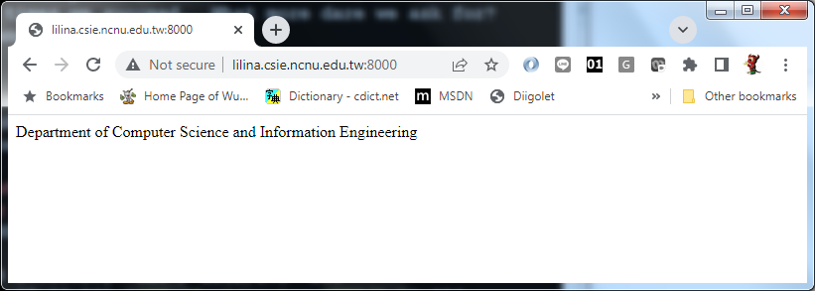
Getting Data from a Webpage
GET http://lilina:8000/
“Department of Computer Science and Information Engineering”
Notes:
flask --app curl-post.py run --port 8000 --host lilina

Slide 6
You can also do this from the command line.
curl http://lilina:8000/
$ curl http://lilina:8000/
Department of Computer Science and Information Engineering

Slide 7
You can do this with a Python program
from urllib.request import urlopen
url = 'http://lilina:8000/'
html = urlopen(url).read().decode()
print(html)

Slide 8
You can also do this with a C program
/* Open a Connection */
#include <stdio.h>
#include <curl/curl.h>
#define URL "http://lilina:8000/"
int main(void)
{
CURL *curl;
CURLcode res;
curl = curl_easy_init();
if(curl) {
curl_easy_setopt(curl, CURLOPT_URL, URL);
res = curl_easy_perform(curl);
if(res != CURLE_OK)
fprintf(stderr, "curl_easy_perform() failed: %s\n",
curl_easy_strerror(res));
curl_easy_cleanup(curl);
}
return 0;
}
Compile with the option “-lcurl”
Notes:
gcc curl-1.c -lcurl -o curl-1.exe

Slide 9
curl-2.c
The previous program simply retrieves a webpage, and prints out the HTML contents.
This just mimics the behavior of the “curl” command.
If you want to store the contents for later usage, you may (dynamically) allocate a memory to store that.
See “curl-2.c”

Slide 10
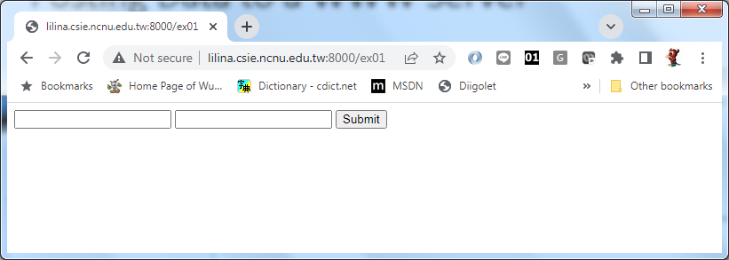
Posting Data to a WWW Server
GET http://lilina:8000/ex01
<FORM METHOD=POST>
<INPUT TYPE=TEXT NAME=A>
<INPUT TYPE=TEXT NAME=B>
<INPUT TYPE=SUBMIT>
</FORM>

Slide 11
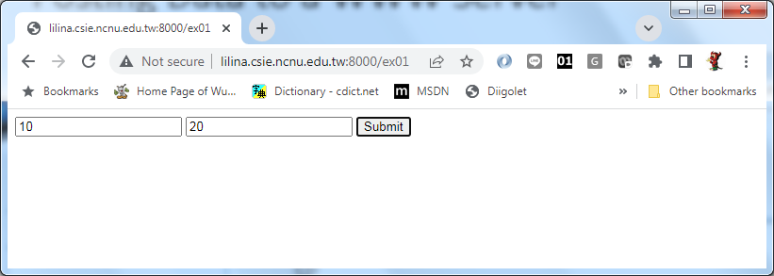
Posting Data to a WWW Server
GET http://lilina:8000/ex01
<FORM METHOD=...
POST http://lilina:8000/ex01
A=10&B=20

Slide 12
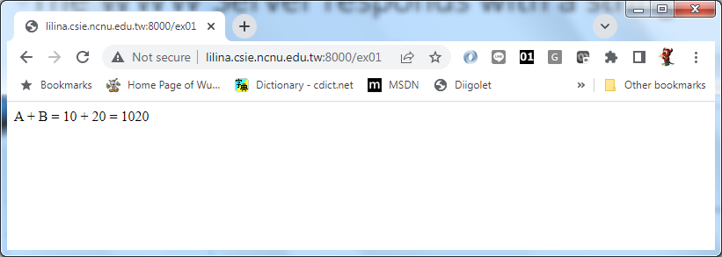
The WWW Server responds with a string
GET http://lilina:8000/ex01
<FORM METHOD=...
POST http://lilina:8000/ex01
A + B = 10 + 20 = 1020

Slide 13
You can do this from a command line
curl http://lilina:8000/ex01
curl -X POST -F "A=10" -F "B=20" http://lilina:8000/ex01
<FORM METHOD=POST>
<INPUT TYPE=TEXT NAME=A>
<INPUT TYPE=TEXT NAME=B>
<INPUT TYPE=SUBMIT>
</FORM>
A + B = 10 + 20 = 1020

Slide 14
You can do this from a Python program
from urllib.request import urlopen
url = 'http://lilina:8000/ex01'
post_str = 'A=10&B=20'.encode()
html = urlopen(url, post_str).read().decode()
print(html)

Slide 15
You can also do this with a C program
curl = curl_easy_init();
if(curl) {
curl_easy_setopt(curl, CURLOPT_URL, WWW);
curl_easy_setopt(curl, CURLOPT_POSTFIELDS, "A=10&B=20");
/* Perform the request, res will get the return code */
res = curl_easy_perform(curl);
/* Check for errors */
if(res != CURLE_OK)
fprintf(stderr, "curl_easy_perform() failed: %s\n",
curl_easy_strerror(res));
/* Always cleanup */
curl_easy_cleanup(curl);
}
Compile with the option “-lcurl”
Notes:
gcc curl-3.c -lcurl -o curl-3.exe

Slide 16
curl-4.c
The previous program simply post data to a WWW server, and prints out the response.
This just mimics the behavior of the “curl” command.
If you want to store the response for later usage, you may (dynamically) allocate a memory to store that.
See “curl-4.c”
Notes:
gcc curl-4.c -lcurl -o curl-4.exe

Slide 17
Why do people prefer Python in Webscraping?
Sir, I know C++ is powerful, but it is just too complicated.
There are 88 lines of C code in “curl-2.c” to retrieve a webpage.
With Python, it takes only 4 lines!
Maybe C program runs faster, but it is faster to write a Python program.
Not necessarily. That’s why you need to learn Object-Oriented Programming.

Slide 18
Encapsulate curl-4.c as an Object
class CRequest {
private:
string url;
string response;
public:
CRequest& urlopen(string s, string post_str = "");
string read();
};

Slide 19
Some details to re-write curl-4.c
reallocate() returns void*, so it must be reinterpret_cast to char*.
The main() stores the retrieved webpage in a dynamically allocated memory which is pointed by chunk.memory, so we construct a string with that and return the string as the response.

Slide 20
Now I can use it in my main program
int main() {
CRequest request;
string html;
html = request.urlopen(URL).read();
cout << html << endl;
html = request.urlopen("http://lilina.csie.ncnu.edu.tw:8000/ex01", "A=5&B=3").read();
cout << html << endl;
return 0;
}
g++ curl-5.cpp -lcurl -o curl-5.exe

Slide 21
Separate the Class Implementation
curl-6.cpp
request.cpp
curl-6.o
request.o
g++
curl
library
curl-6.exe
g++ -c curl-6.cpp
g++ curl-6.o ~solomon/CPP/Curl/request.o -lcurl -o curl-6.exe

Slide 22
Hands-On: Login
Write a C++ program to post a string “STUID=111321xxx” to http://lilina:8000/login.
You can see the result at http://lilina:8000/list

Slide 23
Exercise: Guess a Number
Player
Program
Server
LINE=/new
ID
Guess a Number
50
LINE=ID 50
Too large
Too large
Notes:
co -r1.1 guess.py; flask --app guess.py run --host lilina
g++ guess.cpp myrequest.o request.o -lcurl -o guess.exe

Slide 24
Exercise: Guess a Number
Player
Program
Server
LINE=/new
ID
Guess a Number
50
LINE=ID 50
Too large
Too large
Guess a Number
25
LINE=ID 25
Correct. You find the answer at the 2nd guess.
Correct. You find the answer at the 2nd guess.

