Slide 1
Chapter 13 Object-Oriented Programming: Polymorphism

Slide 2
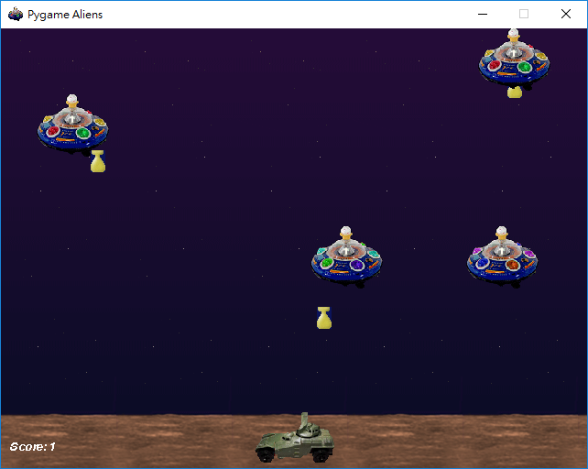
Polymorphic Video Game (P.568)
In OOP, the main program sends messages (calling member functions) to an object.
How an object will react to a message is defined inside the object.
Polymorphism is the ability to send the same message (calling the same function name) to a vector of objects, which each may take different actions.

Slide 3
13.3.1 Invoking Base-Class Functions from Derived-Class Objects (P.570)
L.36 Aiming base-class pointer at base-class object.
commissionEmployeePtr = &commissionEmployee;
commissionEmployeePtr->print();
L.42 Aiming derived-class pointer at derived-class object.
basePlusCommissionEmployeePtr = &basePlusCommissionEmployee;
L.49 Aiming base-class pointer at derived-class object.
commissionEmployeePtr = &basePlusCommissionEmployee;
This is valid, because an object in a derived class also belongs to the base class.
base class: car
derived class: sports car

Slide 4
13.3.2 Aiming Derived-Class Pointers at Base-Class Objects (P.572) - Error
Assign pointer時出錯
L.14 Assigning CommissionEmployee* to BasePlusCommissionEmployee*

Slide 5
13.3.3 Derived-Class Member-Function Calls via Base-Class Pointers (P.574) - Error
You can aim a base-class pointer to a derived-class object. (13.3.1)
However, if you tried to invoke a member function of the derive class via this base-class pointer, the compiler generate an error (L.26).
If the derived class re-defines a member function of the base class, via the base-class pointer, what you invoke is the member function defined in the base class, not the one in the derived class.
This is called static binding or early binding.

Slide 6
13.3.4 Virtual Functions
Declaring a member function is the base class as a virtual function will let the program dynamically (i.e., at runtime) choose which derived-class member function to use, based on the type of the object pointed by the base-class pointer at that time.
This is known as dynamic binding or late binding. (P.576 L.-17)
fig13_06.cpp
L.54 Aim base-class pointer at derived-class object
commissionEmployeePtr = &basePlusCommissionEmployee;
L.61 Polymorphism; invokes BasePlusCommissionEmployee's print()
commissionEmployeePtr->print();
CommissionEmployee.h
L.30 Declare earnings() as a virtual function.
L.31 Declare print() as a virtual function.
BasePlusCommissionEmployee.h
L.20 Declare earnings() as a virtual function.
L.21 Declare print() as a virtual function.
Although this keyword (virtual) can be omitted in derived classes, you should include them for clarity.

Slide 7
13.5 Abstract Classes and Pure virtual Functions
A pure virtual function does not provide an implementation.
virtual void draw() const = 0; // P.582 L.8
If a class has one or more pure virtual functions, it is an abstract class.
You cannot instantiate objects of an abstract class.
You can use the abstract base class to declare pointers referring to objects of all concrete classes derived from this abstract class.
Programs typically use such pointers and references to manipulate derived-class objects polymorphically.

Slide 8
13.9 Virtual Destructors
If a derived-class object with a nonvirtual destructor is destroyed explicitly by applying the delete operator to a base-class pointer to the object, you had to create a virtual destructor in the base class. (P.605 L.9)
When you compile Fig. 13.19, you see a warning: “Employee is abstract but has non-virtual destructor”.
Solution: In Employee.h, add a line
virtual ~Employee() {}

Slide 9
Why Pointers?
Q: Why do we use a vector of pointers (to base class) in this chapter, instead of simply a vector of base-class objects?
A: If you push_back a derived-class object into a vector of base class, the object is cast to a base class object. (New features become lost.)

