Slide 1
Chapter 12 Object-Oriented Programming: Inheritance

Slide 2
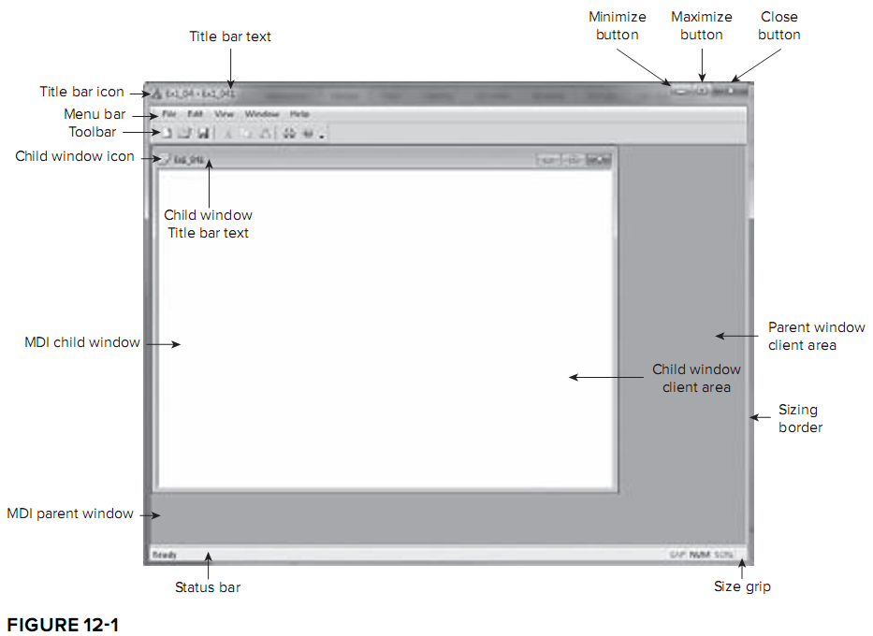
Classes & Windows Programming
The concept of “class” is essential to Windows programming.
We have several objects in Windows programming. Each of them belongs to different classes.
You need to master the concept of classes to utilize these classes in Windows programming.

Slide 3
Object-Oriented Programming (P.533)
Real-world objects belongs to a particular class, which are specified by a common set of parameters (data members) and share a common set of operations (member functions).
Take the “CommunityMember” class for example. There may be different kinds of community members:
Employee, Student, Alumus, …
You may define a class CommunityMember with common attributes,
And add some additional attributes to obtain new classes.
Re-use is the fundamental philosophy of OOP.

Slide 4
Base Class and Derived Class (P.535)
Let’s consider an example. (L.-3)
Commission employees are paid a percentage of their sales.
Base-salaried commission employees receive a base salary plus a percentage of their sales.
CommissionEmployee
firstName
lastName
socialSecurityNumber
gorssSales
commissionRate
BasePlusCommissionEmployee
firstName
lastName
socialSecurityNumber
gorssSales
commissionRate
baseSalary

Slide 5
CommissionEmployee.h (P.536)
public:
CommissionEmployee()
setFirstName()
setLastName()
setSocialSecurityNumber()
setGrossSales()
setCommissionRate()
earnings()
print()
private:
string firstName;
string lastName;
string socialSecurityNumber;
double grossSales;
double commissionRate;

Slide 6
Creating a BasePlusCommissionEmployee Class Without Using Inheritance (P.540)
public:
CommissionEmployee()
setFirstName()
setLastName()
setSocialSecurityNumber()
setGrossSales()
setCommissionRate()
setBaseSalary()
earnings()
print()
private:
string firstName;
string lastName;
string socialSecurityNumber;
double grossSales;
double commissionRate;
double baseSalary;
Inspect BasePlusCommissionEmployee.h and BasePlusCommissionEmployee.cpp, you will notice the similarity between this class and class CommissionEmployee. Most of the code is similar.

Slide 7
Creating a CommissionEmployee-BasePlusCommissionEmployee Inheritance Hierarchy
(P.546)
class BasePlusCommissionEmployee : public CommissionEmployee
{
public:
BasePlusCommissionEmployee( const string &, const string &,
const string &, double = 0.0, double = 0.0, double = 0.0 );
void setBaseSalary( double ); // set base salary
double getBaseSalary() const; // return base salary
double earnings() const; // calculate earnings
void print() const; // print BasePlusCommissionEmployee object
private:
double baseSalary; // base salary
}; // end class BasePlusCommissionEmployee
Compare Fig12.10 (P.547) with Fig12.7 (P.540).
26 lines vs. 45 lines
Compare Fig12.11 with Fig12.8.
48 lines vs. 116 lines

Slide 8
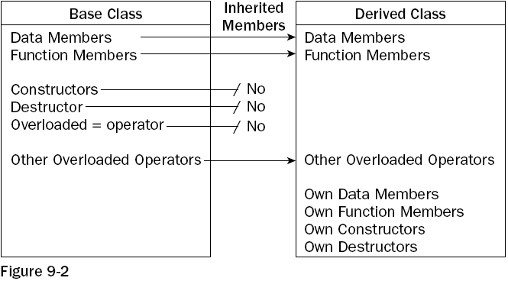
Inheritance
P.535 L.6 friend functions are NOT inherited.

Slide 9
protected members (P.551 L.32)
Private members cannot be accessed from member functions in derived classes.
They should be accessed via public set and get member functions of the base class.
Calling extra functions introduces overhead, so an alternative is to declare your data members as “protected”.
Protected members can be accessed by derived classes, but not by other ordinary global function.
This offers an intermediate level of protection between public and private access.

Slide 10
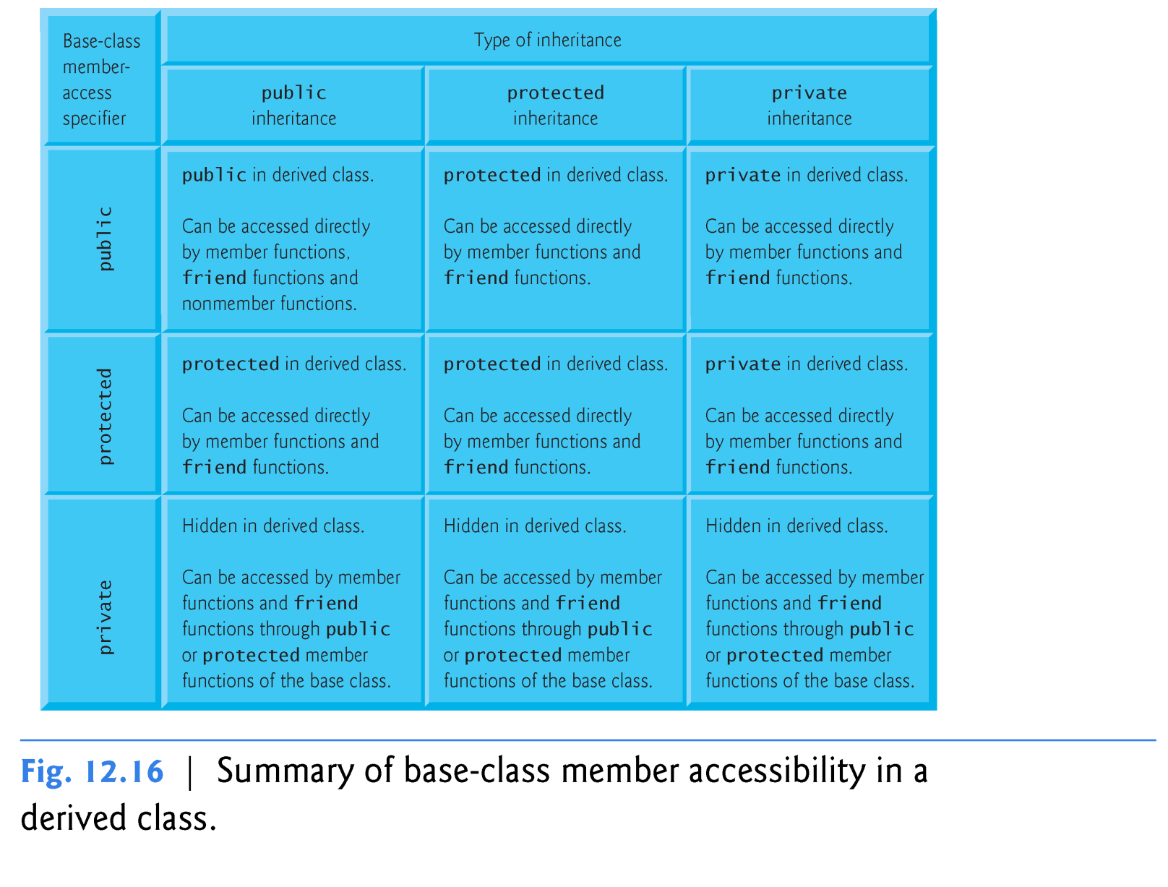
public, protected and private Inheritance (P.559)
We normally use public inheritance in this book.
Use of protected inheritance is rare.
Chapter 20 demonstrates private inheritance as an alternative to composition.
Hidden, not private.

Slide 11
Constructs and Destructors in Derived Classes (P.559)
Software Engineering Observation 12.7
When an object of a derived class is created, it will sequentially invoke
the constructor for the base class’s member objects
the constructor body of the base class
the constructors for the derived class’s member objects
the constructor body of the derived class
When an object is destroyed, destructors are called in the reverse order.
See this example.
String Alice constructor.
Human Alice constructor.
Human Alice destructor.
String Alice destructor.
======
String Emmy constructor.
Human Emmy constructor.
String CSIE constructor.
Employee constructor.
Employee destructor.
String CSIE destructor.
Human Emmy destructor.
String Emmy destructor.

