Slide 1
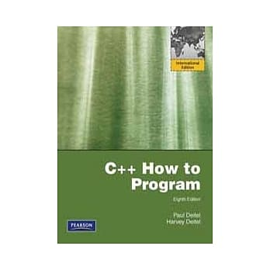
Chapter 8 Pointers
Paul J. Deitel and Harvey M. Deitel,
C++ How to Program,
8th Edition, Pearson Education.

Slide 2
Address-of Operator (&) (P.364) Dereference Operator (*)
int y = 5;
int* yPtr = &y;
*yPtr = *yPtr + 1;
// *&y = *&y + 1;
// y = y + 1;
location 500000
600000
5
yPtr
Q: What will the following code display?
int c = 'A';
int* pc = &c;
cout << *pc;
location 600000
y

Slide 3
Pass-by-Value vs. Pass Pointers to a Function
void inc(int n)
{
n += 10;
cout << n << endl;
}
int main()
{
int n = 10;
inc(n);
cout << n << endl;
return 0;
}
void inc(int* n)
{
*n += 10;
cout << *n << endl;
}
int main()
{
int n = 10;
inc(&n);
cout << n << endl;
return 0;
}
20
10
20
20

Slide 4
8.5 Using const with Pointers (P.371)
#include <iostream>
void show(char* s)
{ std::cout << s << std::endl; }
int main()
{
show("Good morning.");
return 0;
}
Warning: conversion from string literal to 'char *' is deprecated

Slide 5
Four ways to pass a pointer to a function (P.372)
Non-constant Pointer to Non-constant Data
int* pNumber
Non-constant Pointer to Constant Data
const int* sizePtr
Constant Pointer to Non-Constant Data
int* const pArray
Constant Pointer to Constant Data
const int* const pReadOnlyArray

Slide 6
8.6 Selection Sort (P.377)
void selectionSort( int* const array, const int size); // prototype
selectionSort( a, arraySize ); // sort the array
https://www.youtube.com/watch?v=xWBP4lzkoyM

Slide 7
8.7 sizeof Operator (P.379)
The sizeof operator returns the total number of bytes.
The returned value is of type size_t (unsigned int).
You may apply sizeof to a variable or a data type.
int a[10];
class Point { public: int x; int y; };
Point p1;
sizeof a // 40
sizeof a[0] // 4
sizeof a / sizeof a[0] // 10
sizeof(int) // 4
sizeof(p1) // 8
sizeof(Point) // 8
Parenthesis is required when the operand is a data type

Slide 8
8.8 Pointer Arithmetic (P.381)
int v[5];
int* vPtr = v;
int* vPtr = &v[0];
vPtr += 2;
cout << v << vPtr;
++vPtr;
cout << (vPtr - v);
The address is not simply incremented by 2, but size(int)*2.

Slide 9
reinterpret_cast (P.383)
int* and char* are different data types.
Although both are a memory address
int* points to an integer (4 bytes)
char* points to a character (1 byte)
when dereferenced, these two pointers retrieve different data.
Consider the code
char c = 65; int* pc = &c;
Error: cannot convert ‘char*’ to ‘int*’
int* pc = reinterpret_cast<int*>(&c);

Slide 10
pointer to void (void*)
void* is a generic pointer capable of representing any pointer type.
All pointer types can be assigned to a pointer of type void* without casting.
However, a pointer of type void* cannot be assigned directly to a pointer of another type. It must be cast.
char a[4] = { 'A' };
void* pa = a;
int* p = static_cast<int*>(pa); // (int*) pa
cout << reinterpret_cast<int*>( a );

Slide 11
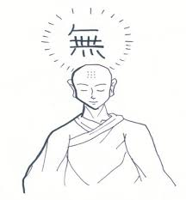
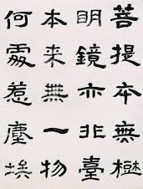
Don’t Mix Up void and void*
void f(int n);
The function returns nothing.
void* g(int n);
The function returns a pointer, which may point to anything.
無
空
It should be named as “generic*”
空明拳是周伯通被黃藥師困於桃花島時，在所住山洞裡自創的武功。
空明拳共有七十二路，第一路空碗盛飯、第二路空屋住人。
一只碗只因為中間是空的，才有盛飯的功用，倘若它是實心的一塊瓷土，還能裝甚麼飯？
建造房屋，開設門窗，只因為有了四壁中間的空隙，房子才能住人。倘若房屋是實心的，磚頭木材四四方方的砌上這麼一大堆，那就一點用處也沒有了。

Slide 12
How to Store a 4-Byte Integers in Memory
16909060 ₁₀ = 0x01020304 (01020304₁₆)
How will it be stored in memory?
01
02
03
04
Big-Endian
Little-Endian
0xA000
01
0xA000
04
0xA001
02
0xA001
03
0xA002
03
0xA002
02
0xA003
04
0xA003
01
Notes:
hex(4660) = ‘0x1234’

Slide 13
Exercise: Big-Endian vs. Little Endian
integer 16909060 is stored at
Using pointer ...
0093FAB8 4
0093FAB9 3
0093FABA 2
0093FABB 1
Using union ...
0093FA7C 4
0093FA7D 3
0093FA7E 2
0093FA7F 1
Big Endian
IBM S/390, Motorola 68k, Sun SPARC,
“Big Endian is Effectively Dead”
Little Endian
Intel x86
Bi-Endian
PowerPC, ARM
On your host, can you write a program to inspect whether it stores integers in big-endian or little-endian?
Notes:
python -c 'import sys; print(sys.byteorder)'

Slide 14
8.9 Relationship Between Pointers and Arrays (P.384)
An array name can be thought of as a constant pointer.
int b[ 5 ];
int *bPtr;
bPtr = b;
bPtr = &b[ 0 ];
b[3] // array subscript notation
*(bPtr + 3) // pointer/offset notation
*(b + 3) // array name is a pointer
bPtr[3] // pointer can be used as an array name

Slide 15
8.12 Function Pointers (P.390)
When you encounter the terminology “callback function” in the future, come back to study this concept again.
Passing a “pointer to function” into a function makes your program flexible.
int add(int a, int b)
{ return a + b; }
int multiply(int a, int b)
{ return a * b; }
int main()
{
int (*f)(int, int);
f = add;
cout << f(12, 3) << endl;
f = multiply;
cout << f(12, 3) << endl; }
The parenthesis cannot be omitted.

Slide 16
An Array of Function Pointers
int add(int a, int b)
{ return a + b; }
int sub(int a, int b)
{ return a - b; }
int multiply(int a, int b)
{ return a * b; }
int divide(int a, int b)
{ return a / b; }
int main()
{
int (*f[4])(int, int) = { add, sub, multiply, divide };
for (int i=0; i<4; ++i)
cout << f[i](12, 3) << endl;
return 0;
}

Slide 17
Callback Function
void show( int a, int b, int (*f)(int, int) )
{ cout << f(a, b) << endl; }
int add(int a, int b)
{ return a + b; }
int sub(int a, int b)
{ return a - b; }
int multiply(int a, int b)
{ return a * b; }
int divide(int a, int b)
{ return a / b; }
int main()
{
int (*f[4])(int, int) = { add, sub, multiply, divide };
for (int i=0; i<4; ++i)
show(12, 3, f[i]);
return 0;
}

